Slide 1
Monitoring Carbon Footprint
Name: R Sanjeev
Institute of Higher Learning: Nanyang Polytechnic
Field Of Study: Engineering
Email: Themarshkateers@gmail.com

Slide 2
Self introduction
My interests: i love coding and learning new topics related to science, technology and engineering by challenging myself with new territories like competitions and etc..
My strengths : I am able to think of solutions very fast if any problems rise up and i am also a very good team player such that we would be able to work very efficiently in any scenario and finally I have a very broad knowledge about science,technology and engineering based topics
My weaknesses: I Usually lose track of time when i am to engrossed into things and forgot about other things
2

Slide 3
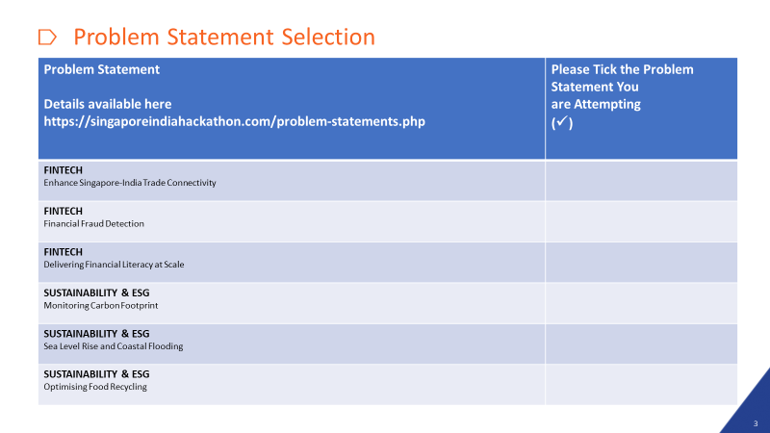

3

Slide 4
Whose problem is it?
Carbon footprint is not a single person's problem as it a global issue that can affect everyone from the youngest to the oldest generations as the increase in carbon footprint will cause the climate to heat up more ,causing the possibility of more droughts and increased intensity of storms occurring. Causing femin due to the lack of water during droughts and loss of shelter during intense storms and many more climate crises.However this is more of the Governments issue as it is the government's responsibility to protect their citizens and the environment from the negative impacts of climate change caused by carbon emissions . Governments play a critical role in setting policies, regulations, and incentives to reduce carbon emissions from various sources such as industry, transportation, and energy production.
4

Slide 5
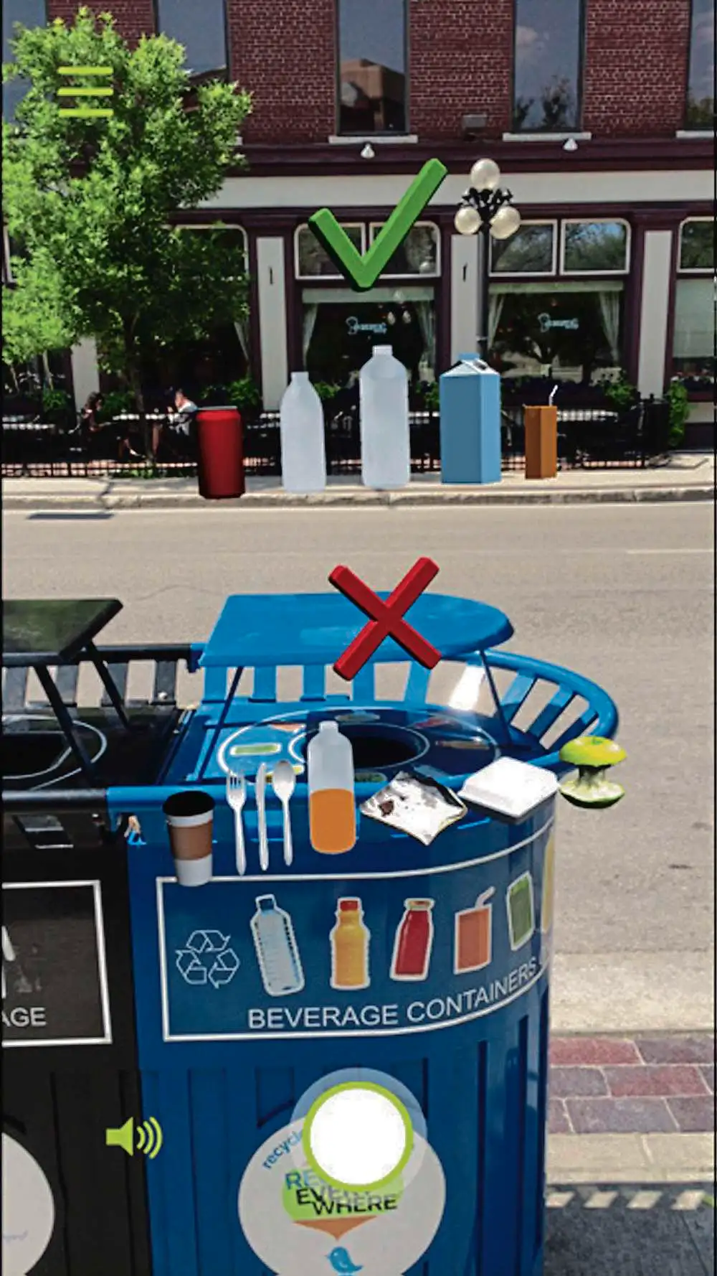
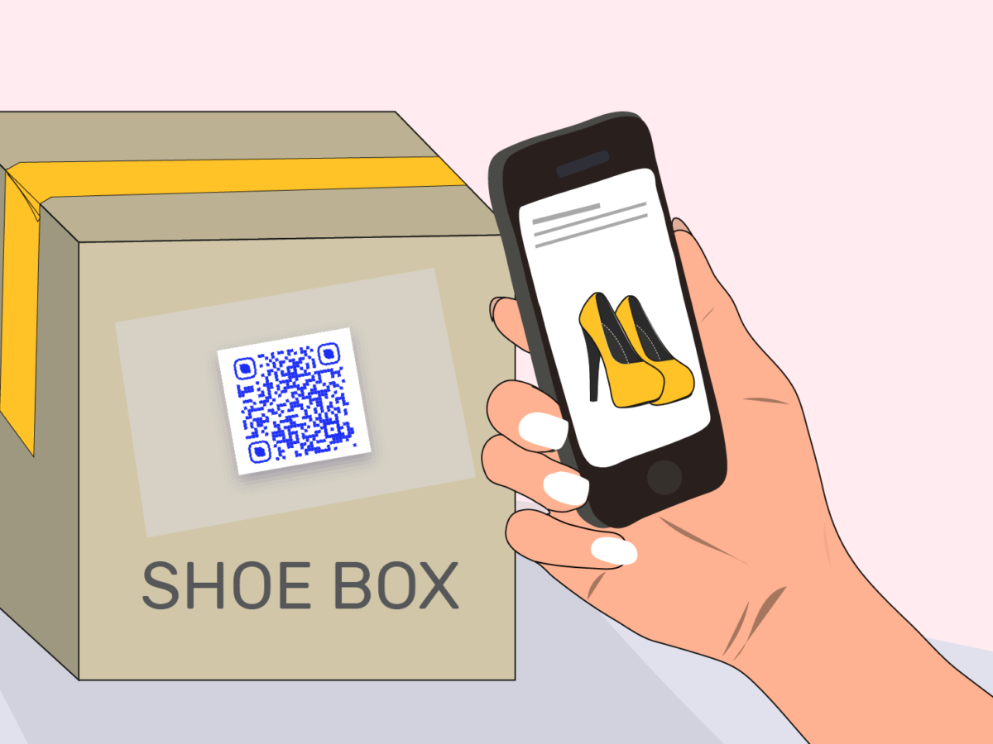
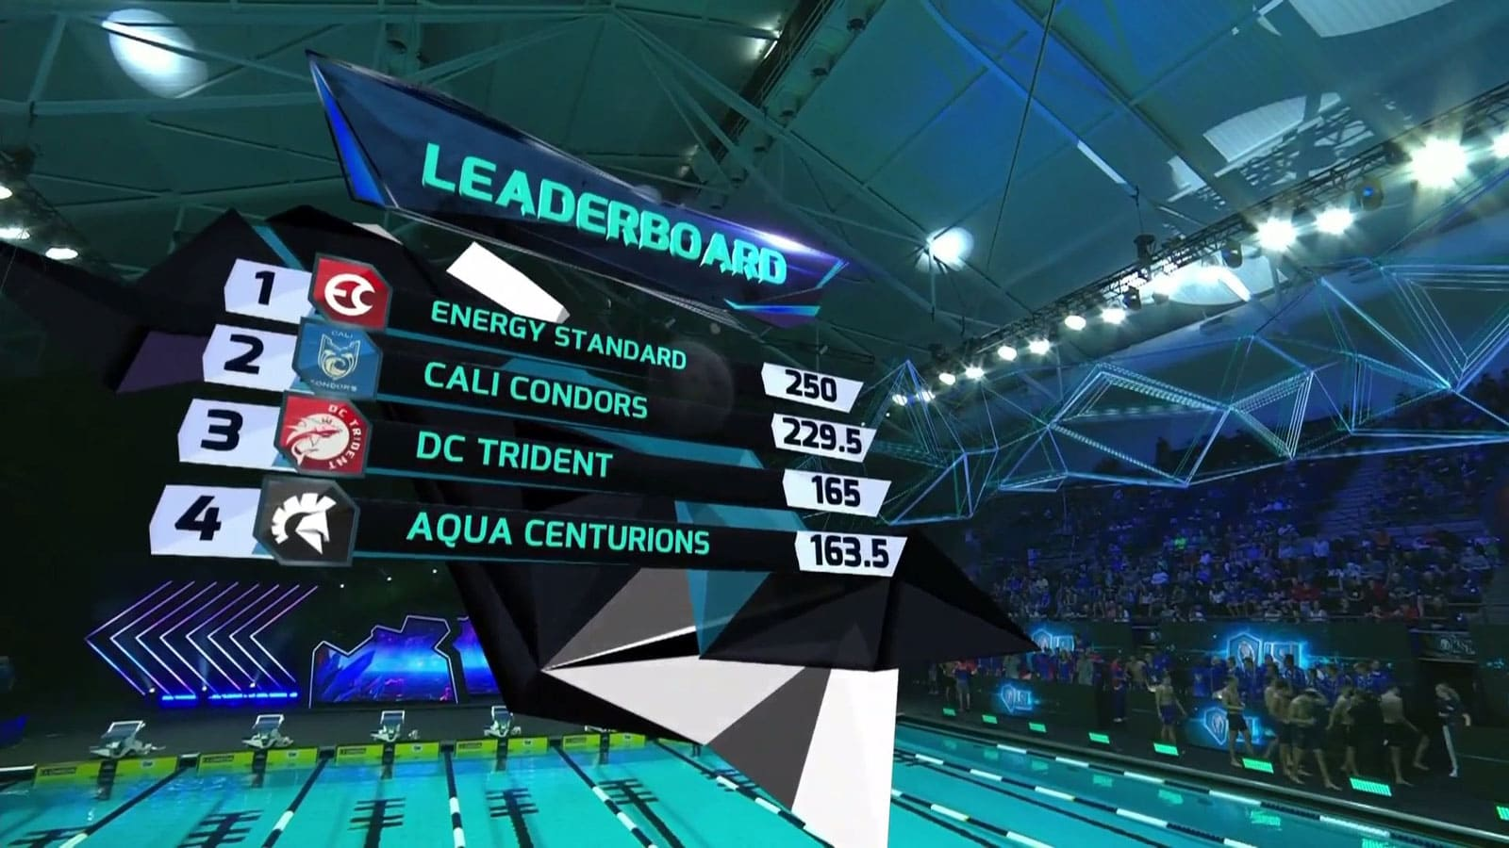
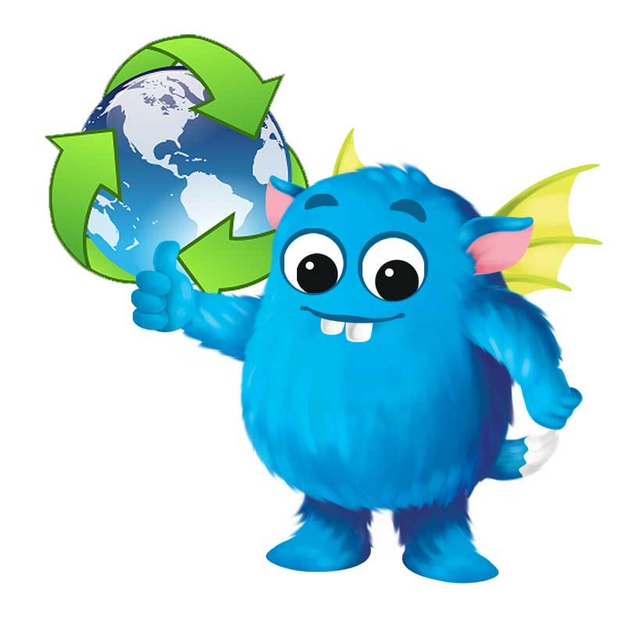
My Idea/Solution
AR Experience
My Idea to educate the consumers on how to reduce their carbon footprint is to create an augmented reality game. When buying an item there would be an QR code that is attached to it and when the consumer uses their phone and scans the qr code there will be an animated cartoon instructing them on what to do with the waste product example cardboard box used for packaging and by following the instructions and taking photo of your action you will gain points. This points will push you up a leaderboard as you will be competing against your friends and others in your phone and you will get incentives based on your rank.
Leaderboard
Scanning the qr code shows an animation to teach you what to do with the waste packaging
5

Slide 6
Incentives
Collaborating with eco-friendly companies like The Body Shop,Ben & Jerry's,and IKEA to offer discounts on their products to players who reach certain milestones or achievements in the game to encourage sustainable behavior and promote the use of environmentally friendly products and encourage them to keep playing the game
The Body Shop uses natural and ethically sourced ingredients in their products, and has a strong commitment to animal welfare and environmental sustainability.
Ben & Jerry's has committed to using 100% renewable energy in its manufacturing facilities by 2025. They have installed solar panels at some of their facilities and purchase renewable energy credits to offset their energy use.
IKEA is working to become more sustainable by using renewable energy, reducing waste, and promoting sustainable materials and production methods
Companies could collaborate with environmental organizations(arborday foundation) to donate a certain amount for every milestone achieved by players in the Augmented Reality recycling game. These donations could be used to support environmental causes such as reforestation, ocean conservation, or renewable energy initiatives(Team Trees,Team Seas).

Slide 7
Distribution
One of the way to distribute the Augmented Reality recycling game, is through the app stores such as the Apple App Store and Google Play Store. we can publish the game on these platforms and make it available for download to users worldwide.
The Augmented Reality recycling game can be promoted via social media platforms such as Facebook, Twitter, Instagram, and LinkedIn by creating ads and sponsored posts to reach a wider audience and encourage them to download and play your game.
We can collaborate with other organizations or businesses that share the vision of promoting recycling and reducing carbon emissions by working with them to distribute your game through their channels, such as their website, social media, or newsletters.
We can organize events and promotions to showcase the game and and can also offer incentives such as discounts or exclusive content to encourage users to download and play your game.

Slide 8
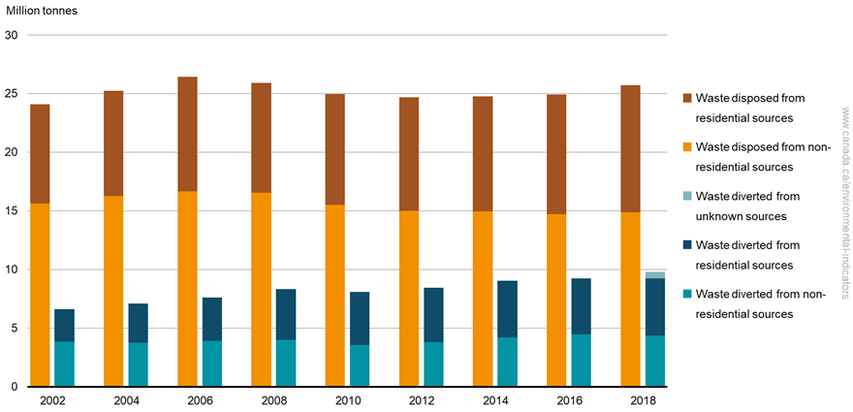
Financial impact
When we recycle, we reduce the amount of waste that is sent to landfills or incinerators. every ton of waste that is diverted from landfills can result in a carbon savings of approximately 3 metric tons of carbon dioxide equivalent.
From 2002 to 2018,the total amount of solid waste generated in Canada increased by 4.8 million tonnes (or 16%) to reach 35.6 million tonnes most of the waste disposal is from the residential sources based on the graph at the top right hand corner.
In Canada, the federal government implemented a coordinated nation-wide carbon price, beginning at $20 per tonne of carbon dioxide equivalent emissions (tCO2e) in 2019 and rising to $50 per tonne as of April 1, 2022 and is set to rise to $170 per tonne by 2030, according to the Government of Canada.
Hence by encouraging more people to recycle causing waste to be diverted from landfills we can reduce the carbon tax that the government is paying.
The augmented reality application would cost around 20k as it is a simple game to create and advertisements can be add into the game so that the users would be also be able to watch the advertisement to get more incentives(powerups) and also there is a chance for other companies to collaborate so that the animated character could promote them for a sum of money increasing the profits that can be gained recovering the money spent on making the game.
6

Slide 9
Performance impact
The Augmented game will have a bigger outreach to the overall public as it is easier to get their hands on the product as it is readily available to everyone on their phones google play or ios app store for free where they can download and use it instead of finding apps via websites that might only work on certain type of phone or even pay for the application.
The augmented game will be able to publicise itself by the younger generation when they discuss or compete with their friends hence this will help publicies the game faster and cheaper instead of making advertisements and banners which cost much more and they do not even pay much attention to it.
An augmented game could increase engagement with a product or service by providing an interactive and immersive experience. This could be particularly effective for products and services that are traditionally viewed as boring or uninteresting like recycling that encourages users to properly sort their waste. The game would provide feedback on the accuracy of the sorting, educate users on the benefits of recycling, and incentivize users to recycle more through rewards via the leaderboard or other in game competitions
7

Slide 10
Image impact
Augmented Reality can provide an interactive and engaging way to educate consumers about the importance of recycling and providing a more interactive and immersive experience on how to recycle different materials. Augmented Reality can increase engagement and interest in recycling initiatives. This can lead to increased demand for recycling products and services, as consumers become more aware of the importance of recycling enhancing the the market acceptance.
Augmented Reality is particularly appealing to the younger generation, who are more tech-savvy and interested in innovative experiences like Augmented Reality. By incorporating Augmented Reality into their recycling products and services, businesses can capture the attention of younger consumers and build brand loyalty, which can translate to increased market share.
Augmented Reality can make the recycling process more convenient for consumers by providing a more user-friendly and intuitive interface. An Augmented Reality app could be used to identify and sort different types of recyclable materials, making it easier for consumers to recycle correctly. By providing a more convenient experience, AR can make recycling products and services more appealing to consumers, leading to increased market share.
8

Slide 11
Competition
How Is My solution better than other Augmented reality recycling games
The Augmented Reality recycling game uses immersive features, such as 3D models, animations, and sound effects, to create a more memorable and impactful learning experience
The Augmented Reality recycling game have a more intuitive and user-friendly interface that makes it easier for users to navigate and understand the recycling information
The Augmented Reality recycling game will cover a wider range of recycling topics, such as composting, and hazardous waste disposal, to provide a more comprehensive education on recycling
The Augmented Reality recycling game incorporates more engaging and challenging gameplay such as puzzles to keep users interested and motivated to learn about recycling
9

Slide 12
Competition
competitors | elaboration | How is my solution better
Traditional Educational Resources | There are many traditional educational resources such as books, articles, and documentaries that provide information on recycling and the environment | It may not be as engaging or interactive as an AR recycling game, which can provide a more immersive and memorable experience
Recycling Games | There are several recycling apps available that help users locate recycling facilities, learn about recycling guidelines, and track their recycling progress | AR recycling game can offer a more immersive and interactive experience by incorporating real-world objects and locations into the gameplay. This can make the learning experience more engaging and memorable for users.
Virtual Reality Experiences | Virtual reality experiences that simulate environmental scenarios can also provide education on recycling and its impact on the environment. | AR recycling game can offer a more accessible and affordable experience by using smartphones and tablets that many people already own. Additionally, an AR recycling game can incorporate real-world objects and locations, making the learning experience more relatable and relevant to users.
Environmental Nonprofits | There are many environmental nonprofits that provide education and resources on recycling and sustainable living | AR recycling game is more interactive by incorporating gamification elements, such as rewards and challenges, an AR recycling game can motivate users to take action and make a positive impact on the environment.
10

Slide 13
Resources link
https://8billiontrees.com/carbon-offsets-credits/carbon-footprint-recycling/#:~:text=One%20ton%20of%20waste%20can,contributes%20massively%20to%20global%20warming.
https://www.canada.ca/en/environment-climate-change/services/environmental-indicators/solid-waste-diversion-disposal.html
https://www2.gov.bc.ca/gov/content/environment/climate-change/clean-economy/carbon-tax#:~:text=In%20Canada%2C%20the%20federal%20government,at%20least%20%2450%20per%20tCO2e
11

